Slide 1
Murach’s ASP.NET Core MVC (2nd Ed.)
Chapter 9
How to work with session state and cookies

Slide 2
Objectives (part 1)
Applied
Use session state to store user data that should persist across multiple requests in a session.
Use cookies to store user data that should persist across multiple sessions.
Knowledge
List the six ways that you can handle state with ASP.NET Core MVC.
Describe how session state works with the focus on the session ID.
Describe how to enable session state for an ASP.NET Core MVC web app, including how to change its default settings.
Describe the use of session state in controllers and views.
Describe how to use JSON to store .NET objects in session state.

Slide 3
Objectives (part 2)
Describe how adding extension methods to the ISession interface can make it easier to store objects in session state.
Describe how a wrapper class can make it easier to work with session state.
Distinguish between a session cookie and a persistent cookie.
Describe the use of cookies, including how to set a persistent cookie.

Slide 4
Common web programming features for maintaining state
Hidden field
Query string
Cookie
Session state
Two ASP.NET Core MVC features for maintaining state
Routes
TempData

Slide 5
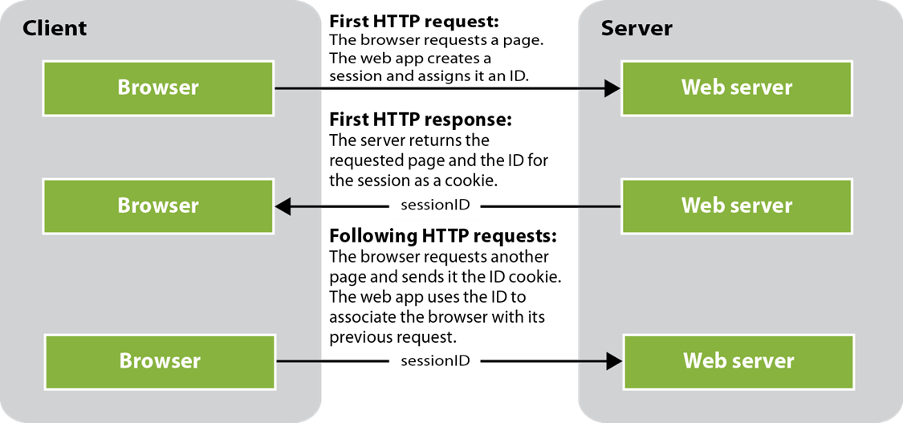
How ASP.NET Core MVC keeps track of a session

Slide 6
How to configure an app to use session state (part 1)
The Program.cs file
...
var builder = WebApplication.CreateBuilder(args);
// must be called before AddControllersWithViews()
builder.Services.AddMemoryCache();
builder.Services.AddSession();
builder.Services.AddControllersWithViews();
...
var app = builder.Build();
// Configure the HTTP request pipeline.
...

Slide 7
How to configure an app to use session state (part 2)
app.UseRouting();
// must be called before routes are mapped
app.UseSession();
...
app.MapControllerRoute(
name: "default",
pattern: "{controller=Home}/{action=Index}/{id?}");
app.Run();

Slide 8
How to change the default session state settings
builder.Services.AddSession(options =>
{
// change idle timeout to 5 minutes - default is 20 minutes
options.IdleTimeout = TimeSpan.FromSeconds(60 * 5);
options.Cookie.HttpOnly = false; // default is true
options.Cookie.IsEssential = true; // default is false
});

Slide 9
Methods of the ISession interface that set, get, and remove items
SetInt32(key, value)
SetString(key, value)
GetInt32(key)
GetString(key)
Remove(key)

Slide 10
An action method that gets and sets a session state value
public ViewResult Index() {
int num = HttpContext.Session.GetInt32("num");
num += 1;
HttpContext.Session.SetInt32("num", num);
return View();
}

Slide 11
A Razor code block that gets a session state value
@{
int num = Context.Session.GetInt32("num");
}
A Razor expression that gets a session state value
<div>@Context.Session.GetInt32("num")</div>

Slide 12
A using directive that imports the JSON library
using System.Text.Json;
Two static methods of the JsonSerializer class
Serialize(object)
Deserialize<T>(string)
Code that sets a Team object in session state
Team team =
new Team { TeamID = "sea", Name = "Seattle Seahawks" };
string json = JsonSerializer.Serialize(team);
HttpContext.Session.SetString("team", json);
Code that gets a Team object from session state
string json = HttpContext.Session.GetString("team");
Team team = JsonSerializer.Deserialize<Team>(json);

Slide 13
How to mark a class property so it’s not included in the serialization
using System.Text.Json.Serialization;
...
public class User
{
public string FirstName { get; set; } = string.Empty;
public string LastName { get; set; } = string.Empty;
[JsonIgnore]
public string FullName => FirstName + " " + LastName;
}

Slide 14
Two extension methods for the ISession interface
using System.Text.Json;
...
public static class SessionExtensions
{
public static void SetObject<T>(this ISession session,
string key, T value)
{
session.SetString(key, JsonSerializer.Serialize(value));
}
public static T? GetObject<T>(this ISession session,
string key)
{
var json = session.GetString(key);
if (string.IsNullOrEmpty(json))
{
return default(T);
}
else
{
return JsonSerializer.Deserialize<T>(json);
}
}
}

Slide 15
Code that uses the extension methods to work with a single team
In a controller
var team =
HttpContext.Session.GetObject<Team>("team") ?? new Team();
team.Name = "Seattle Seahawks";
HttpContext.Session.SetObject("team", team);
In a view
@{
var team =
Context.Session.GetObject<Team>("team") ?? new Team();
}

Slide 16
Code that uses the extension methods to work with a list of teams
In a controller
var teams = HttpContext.Session.GetObject<List<Team>>("teams") ??
new List<Team>();
teams.Add(new Team { TeamID = "gb",
Name = "Green Bay Packers" });
HttpContext.Session.SetObject("teams", teams);
In a view
@{
var teams =
Context .Session.GetObject<List<Team>>("teams") ??
new List<Team>();
}

Slide 17
A wrapper class that encapsulates the code for working with session state
public class MySession
{
private const string TeamsKey = "teams";
private ISession session { get; set; }
public MySession(ISession sess) => session = sess;
public List<Team> GetTeams() =>
session.GetObject<List<Team>>(TeamsKey) ??
new List<Team>();
public void SetTeams(List<Team> teams) =>
session.SetObject(TeamsKey, teams);
}

Slide 18
Code that uses the wrapper class to work with a list of teams
In a controller
var session = new MySession(HttpContext.Session);
var teams = session.GetTeams();
teams.Add(new Team { TeamID = "gb",
Name = "Green Bay Packers" });
session.SetTeams(teams);
In a view
@{
var session = new MySession(Context.Session);
var teams = session.GetTeams();
}

Slide 19
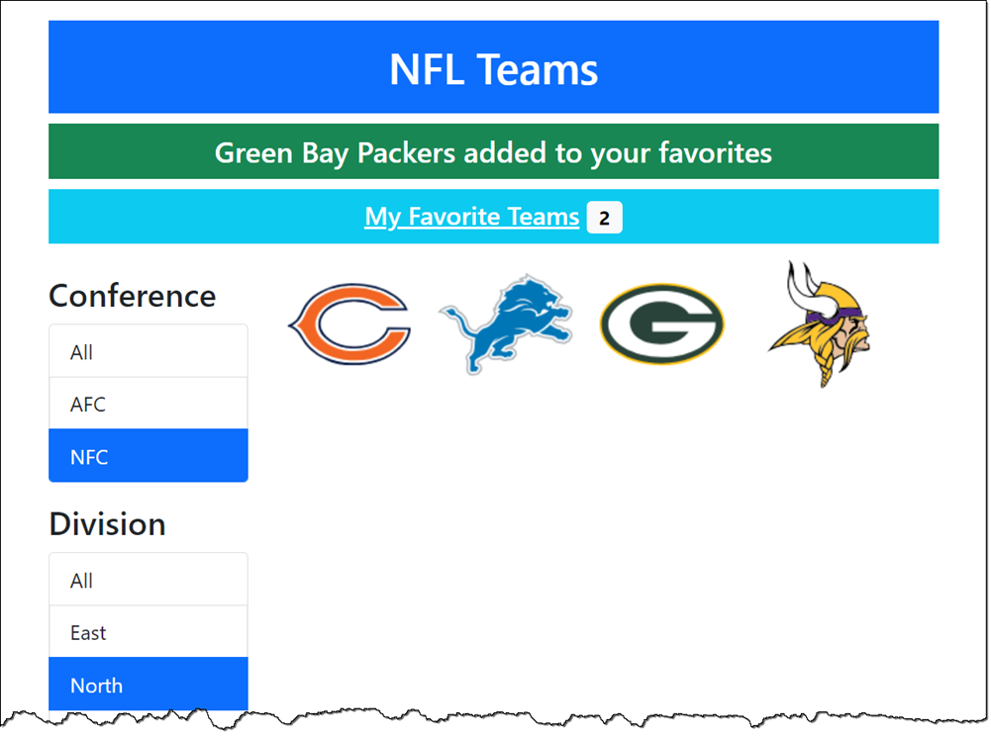
The Home page after a team has been added to favorites

Slide 20
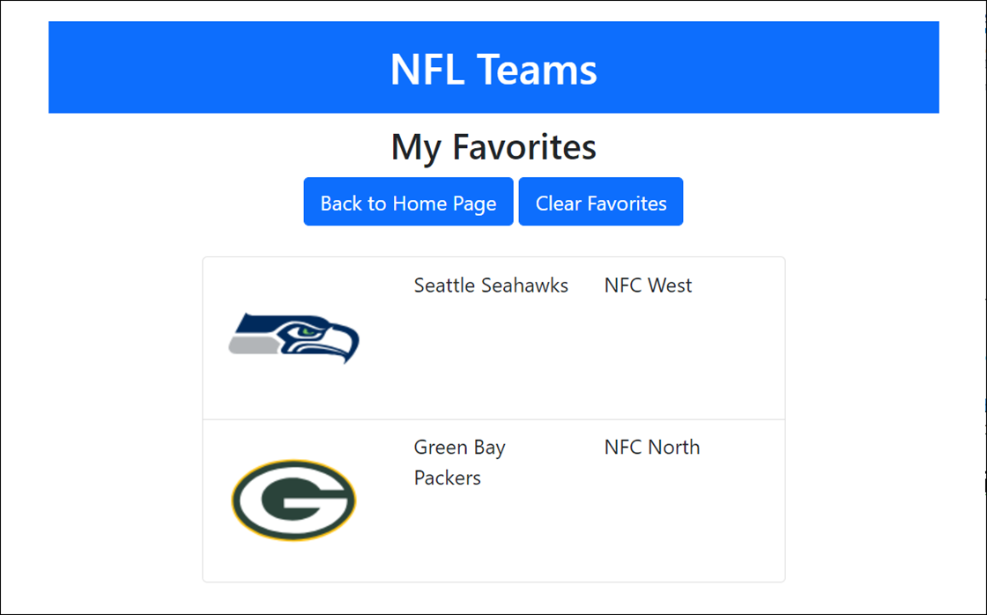
The Favorites page of the NFL Teams 3.0 app

Slide 21
The SessionExtensions class
using System.Text.Json;
...
public static class SessionExtensions
{
public static void SetObject<T>(this ISession session,
string key, T value)
{
session.SetString(key, JsonSerializer.Serialize(value));
}
public static T? GetObject<T>(this ISession session, string key)
{
var json = session.GetString(key);
return (string.IsNullOrEmpty(json)) ? default(T) :
JsonSerializer.Deserialize<T>(json);
}
}

Slide 22
The NFLSession class (part 1)
public class NFLSession
{
private const string TeamsKey = "myteams";
private const string CountKey = "teamcount";
private const string ConfKey = "conf";
private const string DivKey = "div";
private ISession session { get; set; }
public NFLSession(ISession session) =>
this.session = session;
public void SetMyTeams(List<Team> teams) {
session.SetObject(TeamsKey, teams);
session.SetInt32(CountKey, teams.Count);
}
public List<Team> GetMyTeams() =>
session.GetObject<List<Team>>(TeamsKey) ??
new List<Team>();

Slide 23
The NFLSession class (part 2)
public int? GetMyTeamCount() =>
session.GetInt32(CountKey);
public void SetActiveConf(string activeConf) =>
session.SetString(ConfKey, activeConf);
public string GetActiveConf() =>
session.GetString(ConfKey) ?? string.Empty;
public void SetActiveDiv(string activeDiv) =>
session.SetString(DivKey, activeDiv);
public string GetActiveDiv() =>
session.GetString(DivKey) ?? string.Empty;
public void RemoveMyTeams() {
session.Remove(TeamsKey);
session.Remove(CountKey);
}
}

Slide 24
The view model
public class TeamsViewModel
{
// add a property to store a single team
public Team Team { get; set; } = new Team();
// rest of code same as figure 8-10
}

Slide 25
The Home controller (part 1)
public class HomeController : Controller
{
private TeamContext context;
public HomeController(TeamContext ctx) => context = ctx;
public ViewResult Index(TeamsViewModel model)
{
// store selected conference and division in session
var session = new NFLSession(HttpContext.Session);
session.SetActiveConf(model.ActiveConf);
session.SetActiveDiv(model.ActiveDiv);
// populate TeamsViewModel as in figure 8-11
return View(model);
}

Slide 26
The Home controller (part 2)
public ViewResult Details(string id)
{
// get selected conference and division from session
// and pass them to the view in the view model
var session = new NFLSession(HttpContext.Session);
var model = new TeamsViewModel
{
Team = context.Teams
.Include(t => t.Conference)
.Include(t => t.Division)
.FirstOrDefault(t => t.TeamID == id) ?? new Team(),
ActiveConf = session.GetActiveConf(),
ActiveDiv = session.GetActiveDiv()
};
return View(model);
}
}

Slide 27
The layout (part 1)
@{
string controller =
ViewContext.RouteData.Values["controller"]?.ToString() ?? "";
}
<!DOCTYPE html>
<html>
<head>
<meta name="viewport" content="width=device-width,
initial-scale=1.0" />
<link href="~/lib/bootstrap/dist/css/bootstrap.min.css"
rel="stylesheet" />
<link href="~/css/site.css" rel="stylesheet" />
<title>@ViewBag.Title</title>
</head>
<body>
<div class="container">
<header class="text-center text-white">
<h1 class="bg-primary mt-3 p-3">NFL Teams</h1>
@* show any message in TempData *@
@if (TempData.Keys.Contains("message"))
{
<h4 class="bg-success p-2">@TempData["message"]</h4>
}

Slide 28
The layout (part 2)
@* show link to Favorites page unless on page *@
@if (controller != "Favorites")
{
var session = new NFLSession(Context.Session);
int? count = session.GetMyTeamCount();
@* if fave teams in session, display faves link *@
@if (count.HasValue)
{
<h5 class="bg-info p-2">
<a asp-controller="Favorites"
asp-action="Index"
class="text-white">My Favorite Teams</a>
<span class="badge bg-light text-black">
@count</span>
</h5>
}
}
</header>
<main>@RenderBody()</main>
</div>
</body>
</html>

Slide 29
The Home/Details view (part 1)
@model TeamsViewModel
@{
ViewData["Title"] = "Team Details";
}
<h2 class="text-center p-2">Team Details</h2>
<div class="row">
<div class="col">
<ul class="list-group text-center">
<li class="list-group-item">
<img src="~/images/@Model.Team.LogoImage" alt="" />
<h3>@Model.Team.Name</h3>
</li>
<li class="list-group-item">
<h4>Conference: @Model.Team.Conference.Name</h4>
</li>
<li class="list-group-item">
<h4>Division: @Model.Team.Division.Name</h4>
</li>

Slide 30
The Home/Details view (part 2)
<li class="list-group-item">
<form asp-action="Add" asp-controller="Favorites"
method="post">
<a asp-action="Index" class="btn btn-primary"
asp-route-activeConf="@Model.ActiveConf"
asp-route-activeDiv="@Model.ActiveDiv">
Return to Home Page
</a>
<button type="submit" class="btn btn-primary">
Add to Favorites
</button>
<input type="hidden" asp-for="Team.TeamID" />
</form>
</li>
</ul>
</div>
</div>

Slide 31
The Favorites controller (part 1)
public class FavoritesController : Controller
{
private TeamContext context;
public FavoritesController(TeamContext ctx) => context = ctx;
[HttpGet]
public ViewResult Index()
{
var session = new NFLSession(HttpContext.Session);
var model = new TeamsViewModel
{
ActiveConf = session.GetActiveConf(),
ActiveDiv = session.GetActiveDiv(),
Teams = session.GetMyTeams()
};
return View(model);
}

Slide 32
The Favorites controller (part 2)
[HttpPost]
public RedirectToActionResult Add(Team team)
{
team = context.Teams
.Include(t => t.Conference)
.Include(t => t.Division)
.Where(t => t.TeamID == team.TeamID)
.FirstOrDefault() ?? new Team();
var session = new NFLSession(HttpContext.Session);
var teams = session.GetMyTeams();
teams.Add(team);
session.SetMyTeams(teams);
// notify user and redirect to home page
TempData["message"] =
$"{team.Name} added to your favorites";
return RedirectToAction("Index", "Home",
new {
ActiveConf = session.GetActiveConf(),
ActiveDiv = session.GetActiveDiv()
});
}

Slide 33
The Favorites controller (part 3)
[HttpPost]
public RedirectToActionResult Delete()
{
var session = new NFLSession(HttpContext.Session);
session.RemoveMyTeams();
// notify user and redirect to home page
TempData["message"] = "Favorite teams cleared";
return RedirectToAction("Index", "Home",
new {
ActiveConf = session.GetActiveConf(),
ActiveDiv = session.GetActiveDiv()
});
}
}

Slide 34
The Favorites/Index view (part 1)
@model TeamsViewModel
@{
ViewData["Title"] = "Favorites";
}
<div class="text-center mb-4">
<h2>My Favorites</h2>
<form asp-action="Delete" method="post">
<a asp-action="Index" asp-controller="Home"
class="btn btn-primary"
asp-route-activeConf ="@Model.ActiveConf"
asp-route-activeDiv="@Model.ActiveDiv">
Back to Home Page
</a>
<button type="submit" class="btn btn-primary">
Clear Favorites
</button>
</form>
</div>

Slide 35
The Favorites/Index view (part 2)
<div class="row">
<div class="col-8 offset-2">
<ul class="list-group">
@foreach (Team team in Model.Teams)
{
<li class="list-group-item">
<div class="row">
<div class="col-sm-4">
<img src=~/images/@team.LogoImage
alt="" />
</div>
<div class="col-sm-4">
@team.Name
</div>
<div class="col-sm-4">
@team.Conference.Name
@team.Division.Name
</div>
</div>
</li>
}
</ul>
</div>
</div>

Slide 36
Two properties of the Controller class
Request
Response
Code that sets a session cookie
Response.Cookies.Append("username", "Grace");
Code that deletes a cookie
Response.Cookies.Delete("username");
Code that gets a cookie
string value = Request.Cookies["username"];

Slide 37
Properties of the CookieOptions class
Domain
Expires
Path
MaxAge
SameSite
Secure
Code that sets a persistent cookie
var options = new CookieOptions {
Expires = DateTime.Now.AddDays(30)
};
Response.Cookies.Append("username", "Grace", options);

Slide 38
The NFLCookies class (part 1)
public class NFLCookies
{
private const string TeamsKey = "myteams";
private const string Delimiter = "-";
private IRequestCookieCollection requestCookies { get; set; } =
null!;
private IResponseCookies responseCookies { get; set; } = null!;
public NFLCookies(IRequestCookieCollection cookies) {
requestCookies = cookies;
}
public NFLCookies(IResponseCookies cookies) {
responseCookies = cookies;
}

Slide 39
The NFLCookies class (part 2)
public void SetMyTeamIds(List<Team> myteams) {
List<string> ids = myteams.Select(t => t.TeamID).ToList();
string idsString = String.Join(Delimiter, ids);
CookieOptions options = new CookieOptions {
Expires = DateTime.Now.AddDays(30)
};
RemoveMyTeamIds(); // delete old cookie first
responseCookies.Append(TeamsKey, idsString, options);
}
public string[] GetMyTeamsIds() {
string cookie = requestCookies[MyTeams] ?? String.Empty;
if (string.IsNullOrEmpty(cookie))
return Array.Empty<string>(); // empty string array
else
return cookie.Split(Delimiter);
}
public void RemoveMyTeamIds() {
responseCookies.Delete(TeamsKey);
}
}

Slide 40
The Index() action method of the Home controller
public ViewResult Index(TeamsViewModel model)
{
var session = new NFLSession(HttpContext.Session);
session.SetActiveConf(model.ActiveConf);
session.SetActiveDiv(model.ActiveDiv);
// if no count in session, get cookie and restore fave teams
int? count = session.GetMyTeamCount();
if (!count.HasValue) {
var cookies = new NFLCookies(Request.Cookies);
string[] ids = cookies.GetMyTeamIds();
if (ids.Length > 0) {
var myteams = context.Teams.Include(t => t.Conference)
.Include(t => t.Division)
.Where(t => ids.Contains(t.TeamID)).ToList();
session.SetMyTeams(myteams);
}
}
// populate TeamsViewModel as in figure 8-11
return View(model);
}

Slide 41
The Add() action method of the Favorites controller
[HttpPost]
public RedirectToActionResult Add(Team team) {
team = context.Teams
.Include(t => t.Conference).Include(t => t.Division)
.Where(t => t.TeamID == team.TeamID)
.FirstOrDefault() ?? new Team();
var session = new NFLSession(HttpContext.Session);
var cookies = new NFLCookies(Response.Cookies);
var teams = session.GetMyTeams();
teams.Add(team);
session.SetMyTeams(teams);
cookies.SetMyTeamIds(teams);
TempData["message"] = $"{team.Name} added to your favorites";
return RedirectToAction("Index", "Home",
new {
ActiveConf = session.GetActiveConf(),
ActiveDiv = session.GetActiveDiv()
});
}

Slide 42
The Delete() action method of the Favorites controller
[HttpPost]
public RedirectToActionResult Delete()
{
var session = new NFLSession(HttpContext.Session);
var cookies = new NFLCookies(Response.Cookies);
session.RemoveMyTeams();
cookies.RemoveMyTeamIds();
TempData["message"] = "Favorite teams cleared";
return RedirectToAction("Index", "Home",
new {
ActiveConf = session.GetActiveConf(),
ActiveDiv = session.GetActiveDiv()
}
);
}

